Slide 1
Spam Email Classification
University of Toronto
School of Continuing Studies
SCS 3251 - Statistics for Data Science
Student: Arjie Cristobal
Professor: Dr. Sergiy Nokhrin
August 2023

Slide 2
Objective
Classify if the email is spam or not using Binary Classification.
Determine whether feature selection can help in the classification of spam emails.
Stepwise Backward Elimination Pearson Correlation Chi-squared

Slide 3



Data Preparation
Data Source:
Spambase - Classifying Email as Spam or Non Spam
Procurement:
Spambase Dataset Loader - Loading and preparing the dataset.

Slide 4
Data Preparation
Data Exploration
Dataset is already in good quality because it is already sanitized.
Standard check using info() describe() etc., was conducted.
There are no null or NaN values
All variables are in correct type
There are no categorical variables present that needs OneHotEncoder.
The dataset consist of 4601 rows and 58 features.

Slide 5


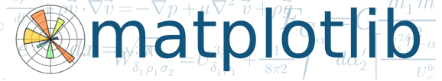

Data Preparation - Tools

Slide 6
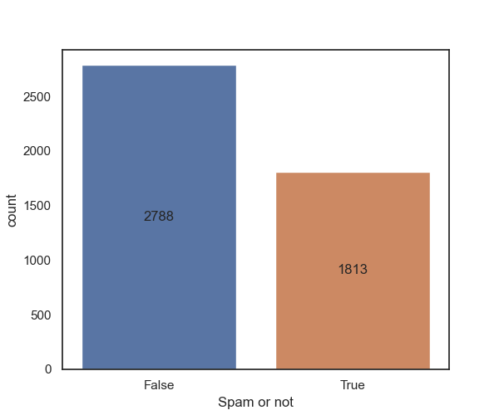
Data Preparation - Challenges
Imbalance Dataset

Slide 7
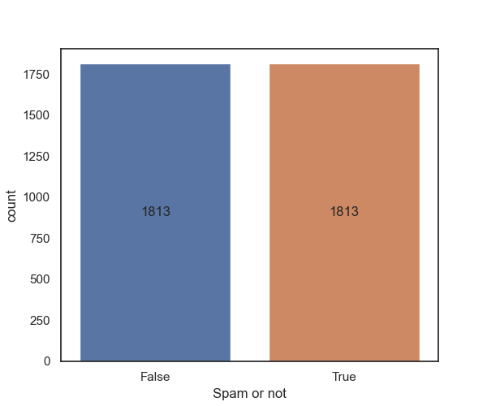
Data Preparation - Solutions
Imbalance Dataset Solutions
Collecting more Data
Generating Synthetic Samples
Resampling the Dataset
Using different Performance Metric

Slide 8
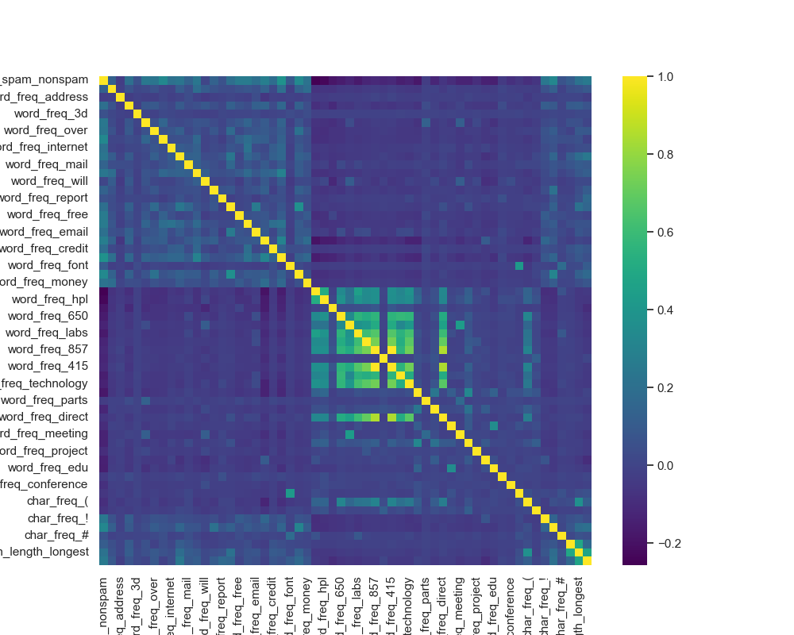
Data Preparation - Challenges
Large number of Features and lack of detailed description of each Features.

Slide 9
Data Preparation - Solutions
Large number of Features and lack of detailed description of each Features
Solutions:
Stepwise model selection strategies
Forward Selection
Backward Elimination
Pearson Correlation
Chi-squared

Slide 10
Model
The study introduced Spambase Model Helper to produce a predictive model.
Perform feature selection prior on fitting the model.
Fit the model to Logit of StatsModels.
Process, display and plot the Confusion Matrix.
Calculate the Accuracy, Precision, Recall and F1-Score.
Plot the scores.

Slide 11
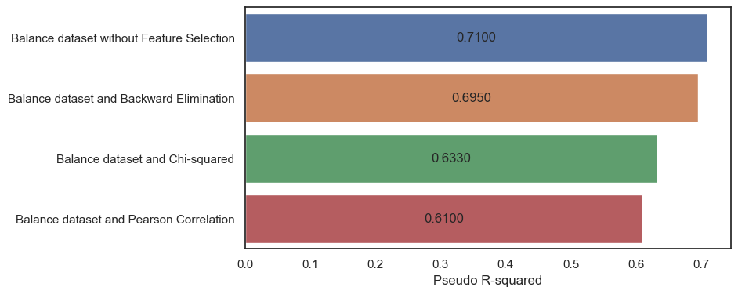
Model Evaluation
The Pseudo R-squared is on a scale from 0 to 1, with higher values meaning a better fit.

Slide 12
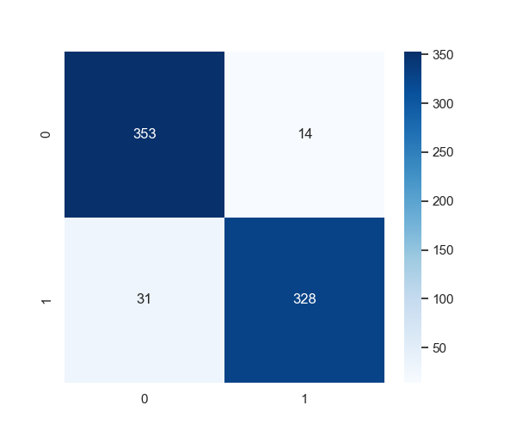
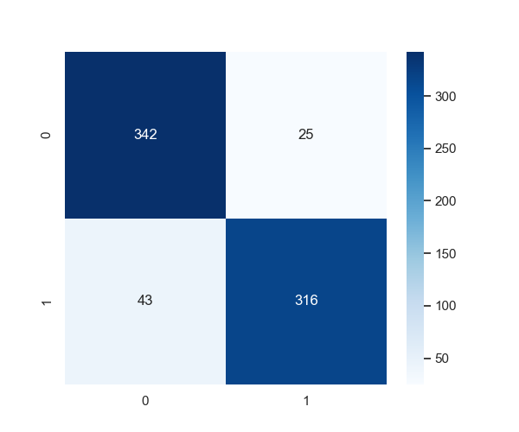
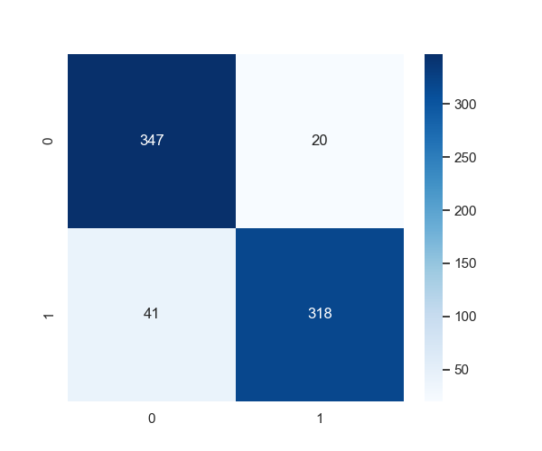

Model Evaluation
Confusion Matrix - There are more TP and TN compared to FP and FN which is a positive sign for a good model.
Balance Dataset and Backward Elimination Technique
Balance Dataset and Pearson Correlation
Balance Dataset and Chi-squared
Balance Dataset without Feature Selection

Slide 13
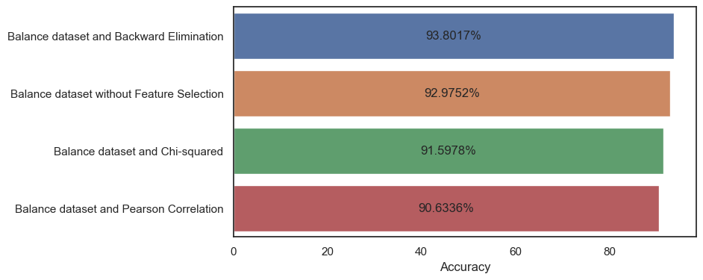
Model Evaluation
Statistical Accuracy

Slide 14
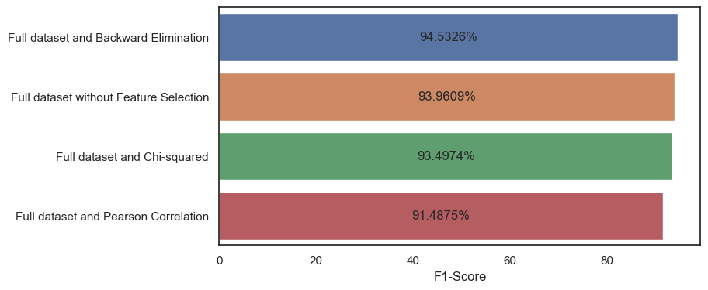
Data Preparation - Model
Evaluation - Statistical Accuracy (Full / Imbalance Dataset)

Slide 15
Conclusion
The study was able classify spam emails by using Binary Classification and produce a working model.
The study also proves that feature selection can sometimes help in the classification.
Future Study
The dataset was already old thus an updated dataset was needed.
The use of other classification based Machine Learning models and corresponding hyperparameters to further improve the performance is recommended.

